Slide 1
Software Development Life Cycle Development Using Multi-Agentic Gen AI Framework
Ramya Pogula
Kowshikreddy Chinthareddy
Ashish Kumar Jaiswal Ramdayal

Slide 2
Project overview
Automated SDLC Processes: Streamlines software development life cycle workflows using Langchain agentic framework by taking the requirements as the input.
AI-Driven Task Management: Employs Generative AI-based coding, reviewing, testing, documentation and deployment.
Modular and Scalable: Features a customizable and scalable framework adaptable to diverse project requirements and growing operational demands.
User-Friendly Interface: Leverages Gradio for an intuitive interface, facilitating seamless interactions and enhanced team collaboration throughout the development lifecycle.

Slide 3
Problem Statement
Complex SDLC Processes: Managing SDLC workflows manually is time-intensive, prone to errors, and lacks efficiency in collaborative environments.
Inefficient Resource Allocation: Challenges in prioritizing tasks and assigning resources lead to delayed project deliverables and increased development costs.
Limited Automation: Absence of automation in SDLC stages impacts productivity, increasing redundancy and reducing the focus on core development.
Scalability Issues: Traditional methods struggle to accommodate evolving requirements and growing project complexities in a dynamic development environment.

Slide 4
Methodology
Requirements Input:
User provides initial requirements through a user-friendly Gradio interface.
State Graph Initialization:
The SDLC workflow is modeled using a StateGraph, defining nodes (tasks) and edges (task transitions).
Task Execution via Agents:
Specialized agents execute tasks for each SDLC phase:
Coding Agent: Generates code based on the requirements.
Review Agent: Analyzes and improves the generated code.
Testing Agent: Creates and evaluates test cases.
Documentation Agent: Generates detailed documentation.
Deployment Agent: Prepares and finalizes deployment scripts.

Slide 5
Methodology
Real-Time Workflow:
Tasks are executed sequentially, with real-time progress updates and outputs displayed in the interface.
Content Saving:
Outputs from each phase (code, test cases, documentation, and deployment scripts) are saved automatically in a structured directory.
Interactive User Decision:
At the end of the workflow, the system prompts the user to save or discard the generated content.

Slide 6
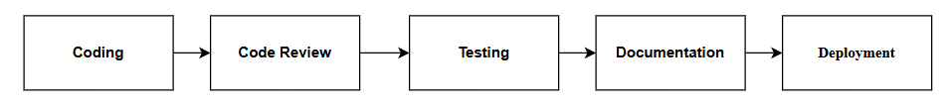
Project Pipeline
Coding: Requirements are translated into modular, PEP-8-compliant code by the Coding Agent.
Code Review: The Review Agent evaluates the generated code for adherence to standards, readability, and scalability.
Testing: The Testing Agent creates comprehensive test cases to validate the functionality and robustness of the code.
Documentation: The Documentation Agent generates detailed technical documentation.
Deployment: The Deployment Agent automates the process of deploying the finalized code to GitHub or other platforms.

Slide 7
Key Features
Automated SDLC Workflow:
Seamlessly integrates and automates key SDLC phases: Coding, Review, Testing, Documentation, and Deployment.
Real-Time Progress Updates:
Provides live feedback on each phase, ensuring clear visibility and tracking of the workflow.
Multi-Agent Task Execution:
Leverages specialized agents for efficient execution of SDLC tasks, tailored to each phase.
Automated Code Saving:
Saves generated code, test cases, documentation, and deployment scripts in a structured directory automatically.
Interactive Gradio Interface:
User-friendly interface for easy input of requirements and interaction throughout the workflow.

Slide 8
Implementation Steps
Input Requirements:
The user enters project requirements through an intuitive Gradio interface.
Workflow Initialization:
The system initializes the SDLC Workflow, displaying a progress tracker.
Real-Time Execution:
Each SDLC phase is executed step-by-step:
Coding Phase: Generates code based on the provided requirements.
Review Phase: Refines and reviews the code for quality.
Testing Phase: Generates and executes test cases.
Documentation Phase: Creates detailed project documentation.
Deployment Phase: Produces deployment-ready scripts.

Slide 9
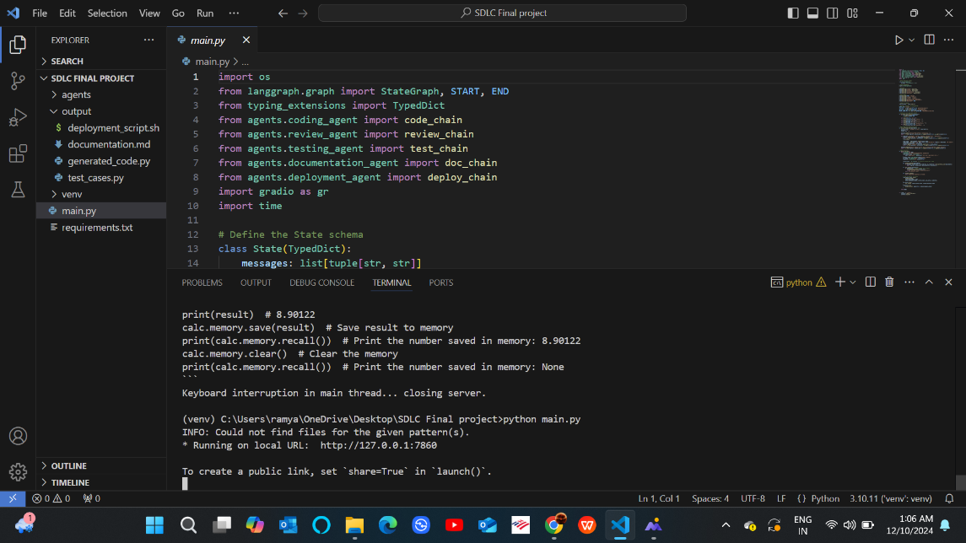
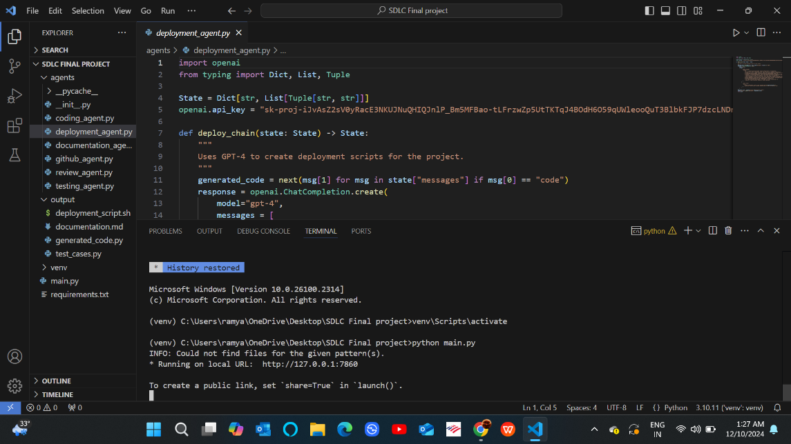
Project File Structure

Slide 10
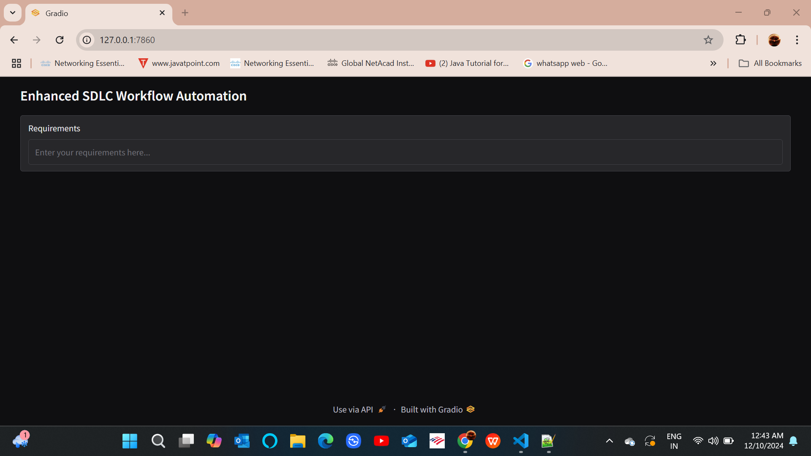
Requirements UI

Slide 11
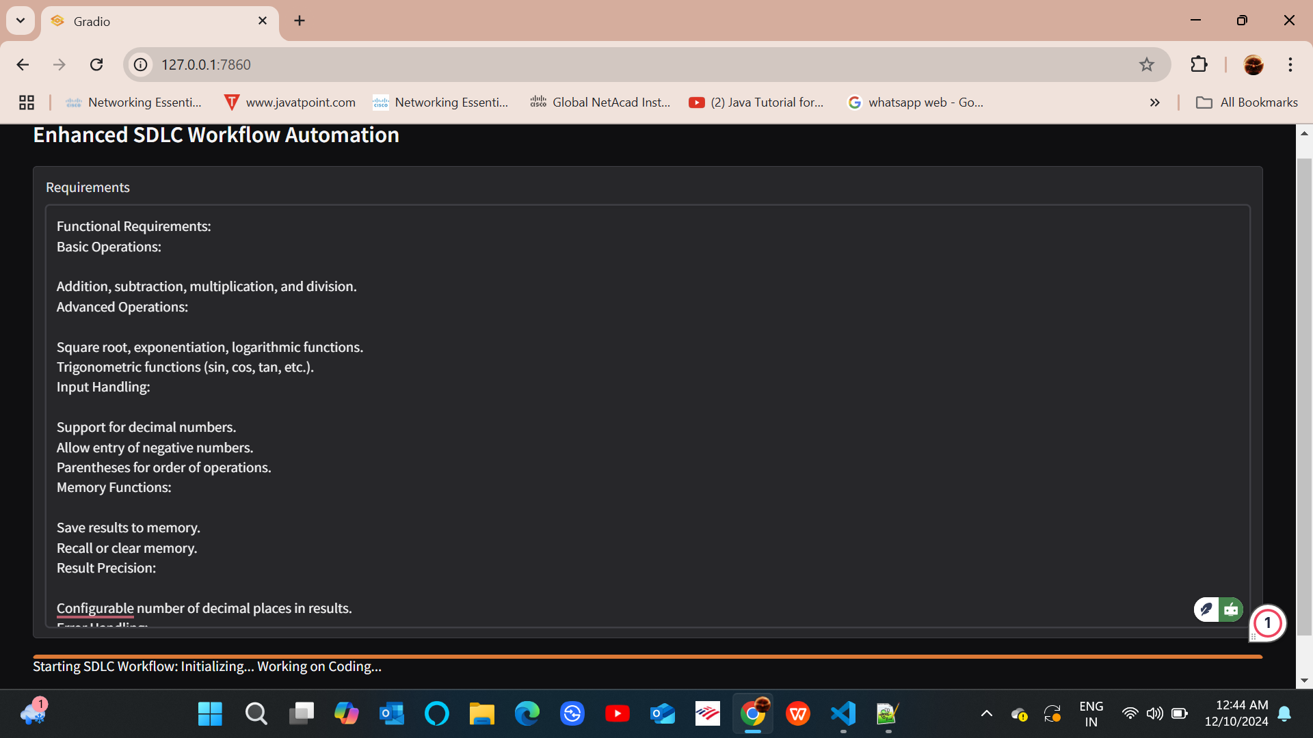
Starting SDLC Workflow Initializing Working on the code

Slide 12
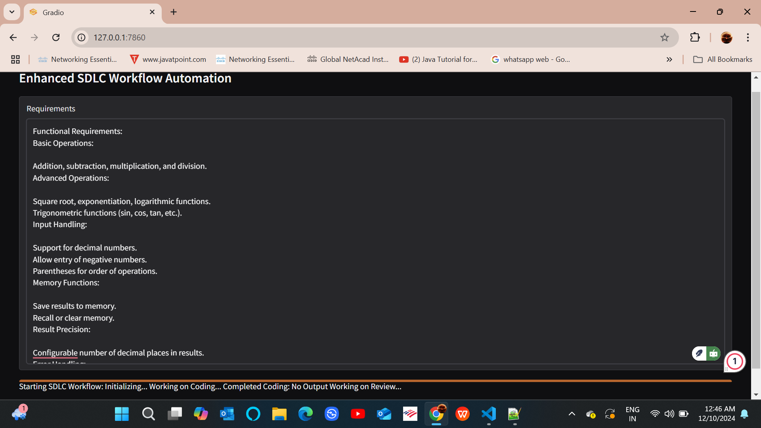
Starting SDLC Workflow Initializing… Working on Coding… Completed Coding: No Output Working on Review

Slide 13
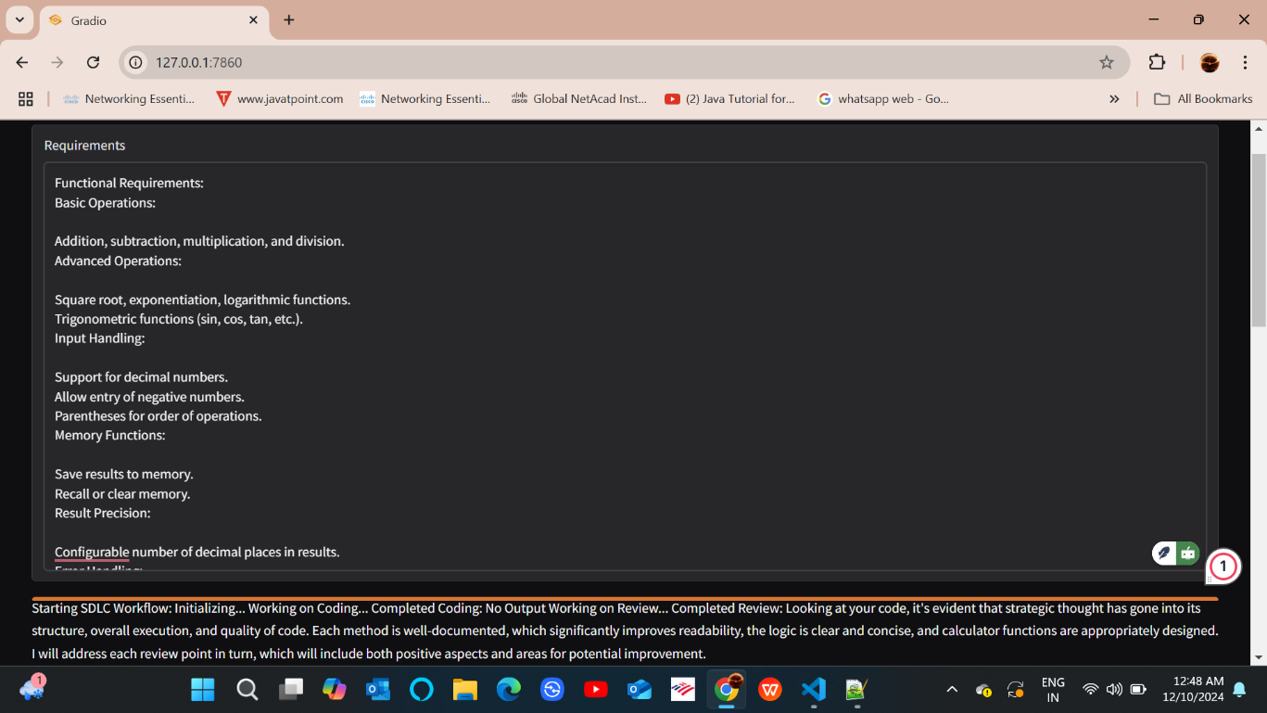
Starting SDLC Workflow: Initializing... Working on Coding... Completed Coding: No Output Working on Review... Completed Review
Looking at your code, it's evident that strategic thought has gone into its structure, overall execution, and quality of code. Each method is well-documented, which significantly improves readability, the logic is clear and concise, and calculator functions are appropriately designed. will address each review point in turn, which will include both positive aspects and areas for potential improvement.

Slide 14
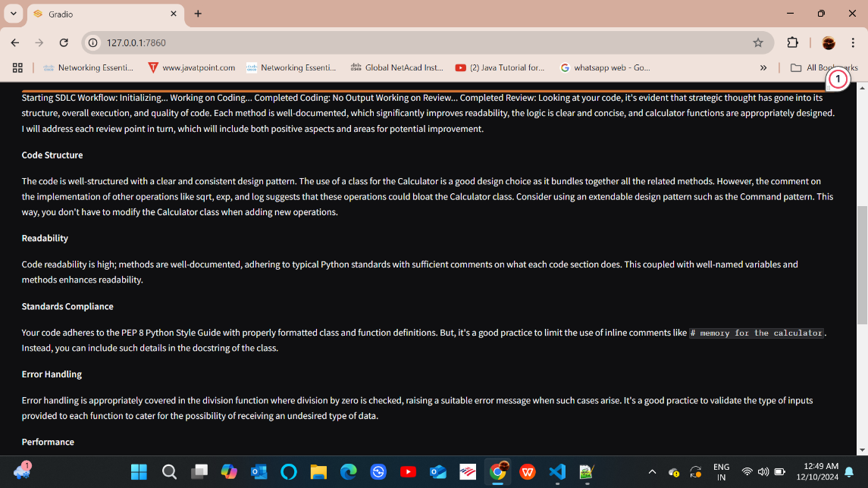
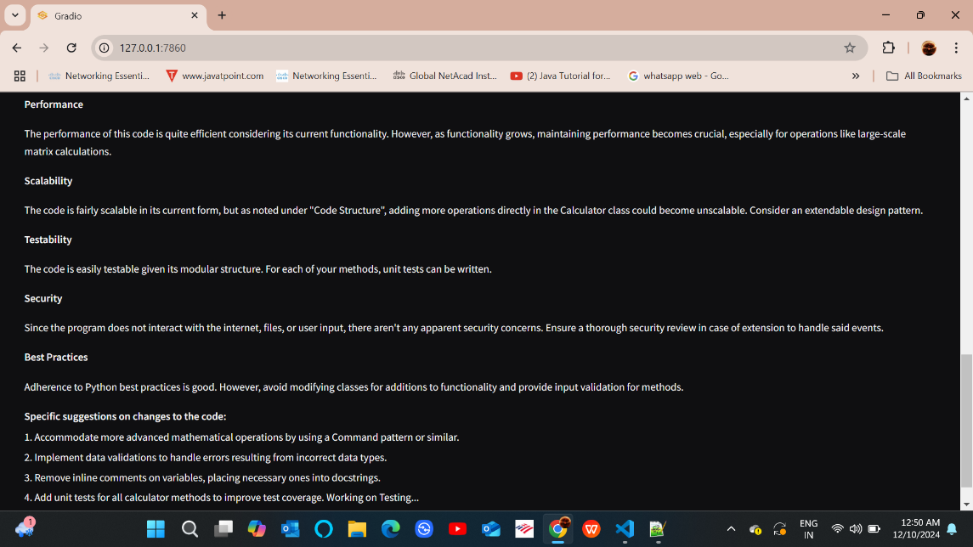
Working on Testing

Slide 15
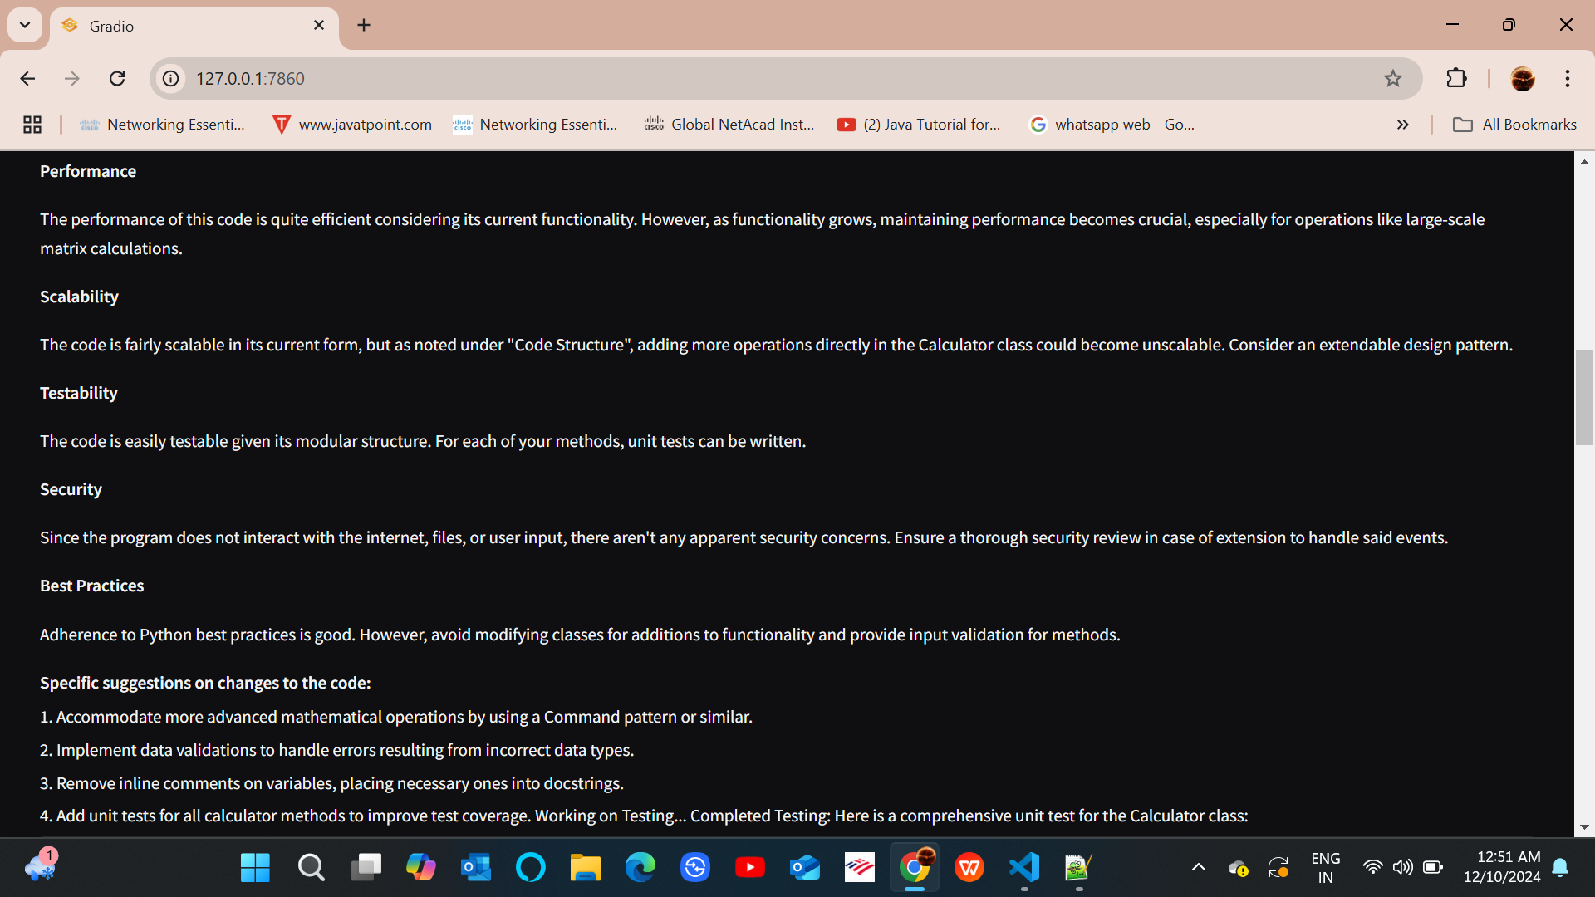
Completed Testing: Working on Unit Test class

Slide 16
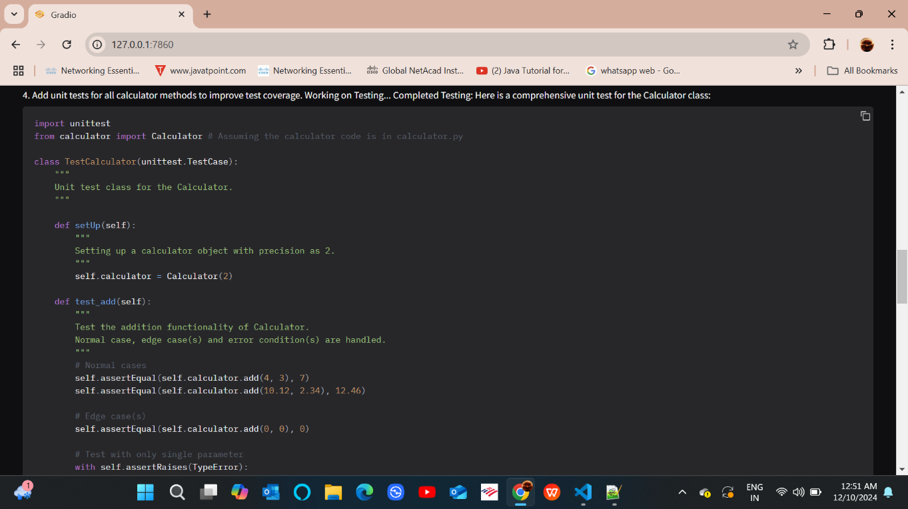
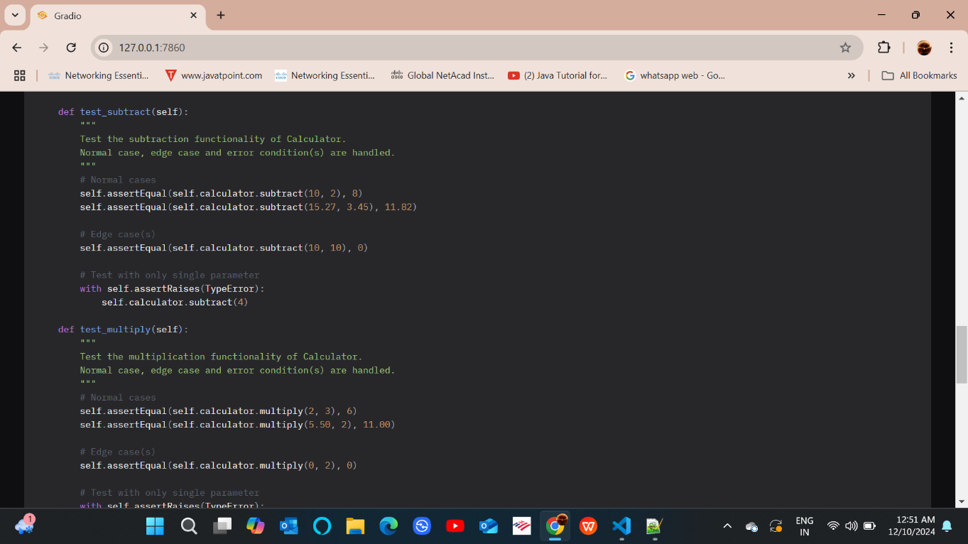
Glimpse of Unit Test

Slide 17
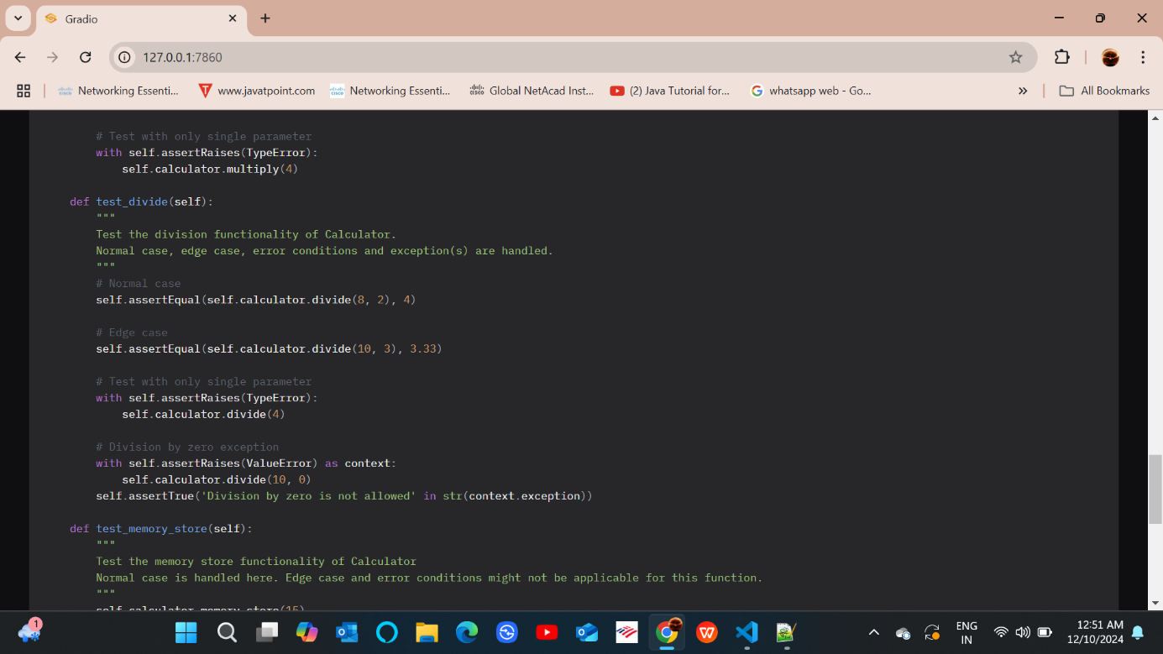
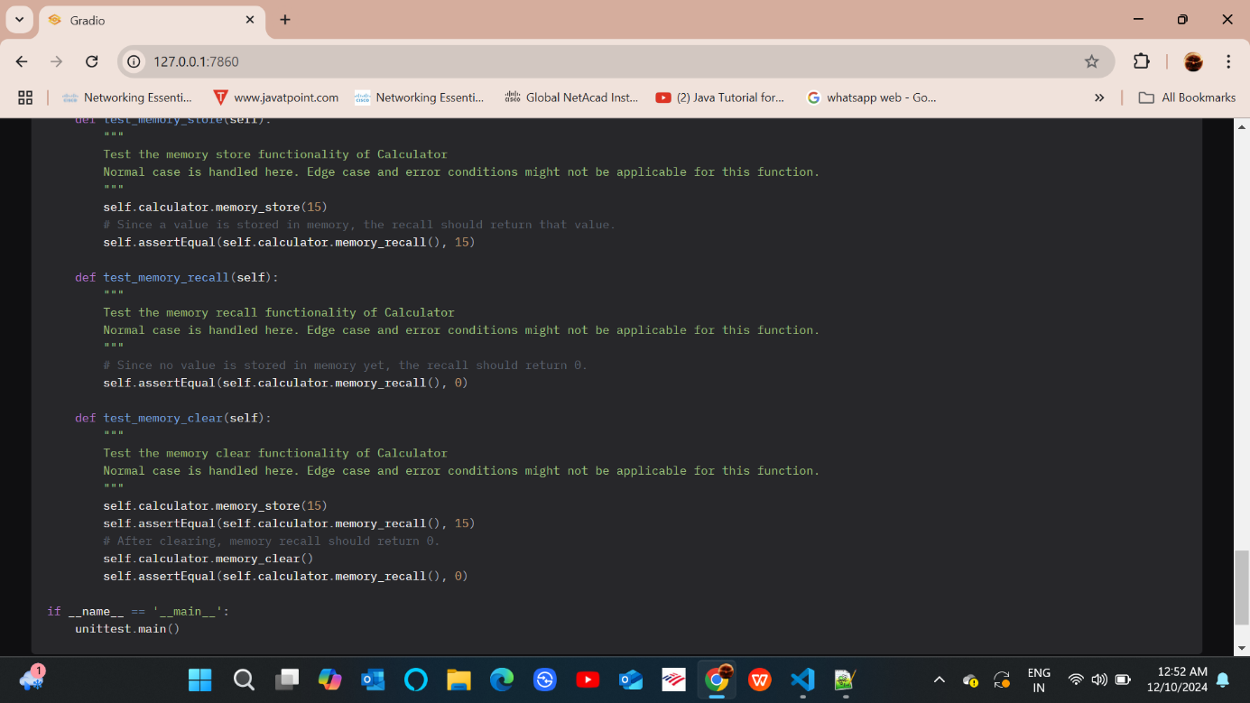
Glimpse of Unit Test

Slide 18
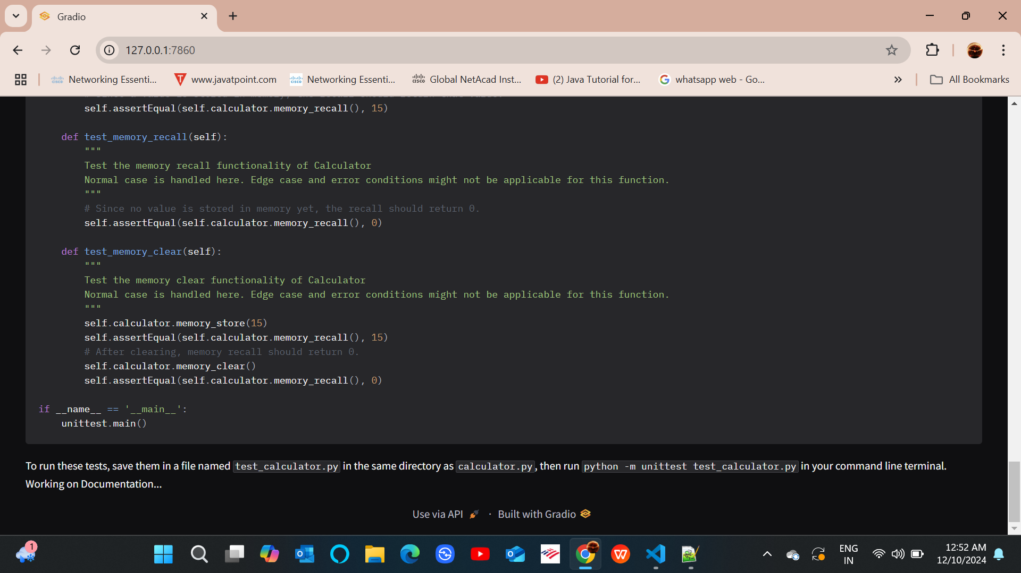
To run these tests, save them in a file named test_calculator.py in the same directory as calculator.py, then run python - unittest test_calculator.py in your command line terminal.
Working on Documentation...

Slide 19
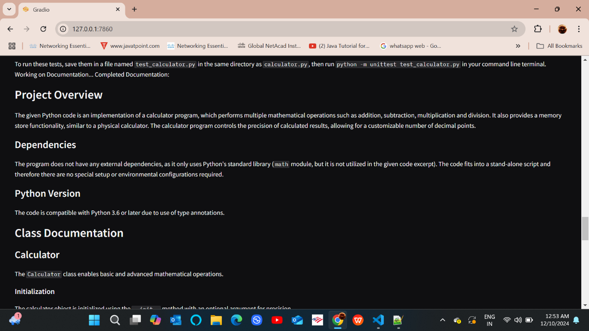
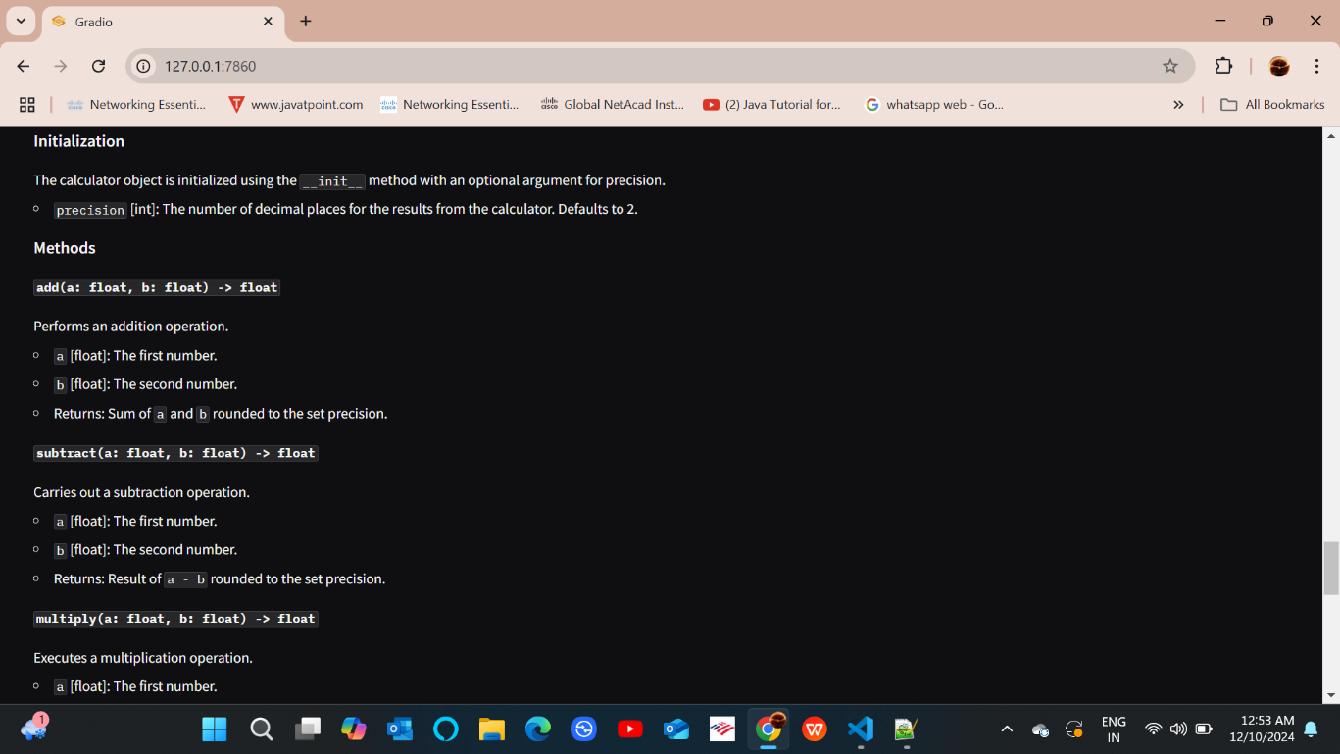
Documentation

Slide 20
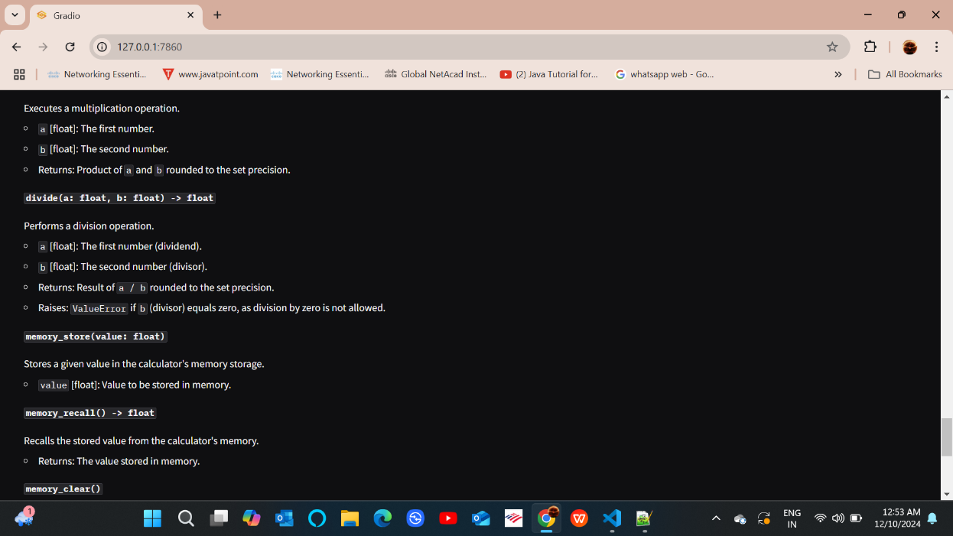
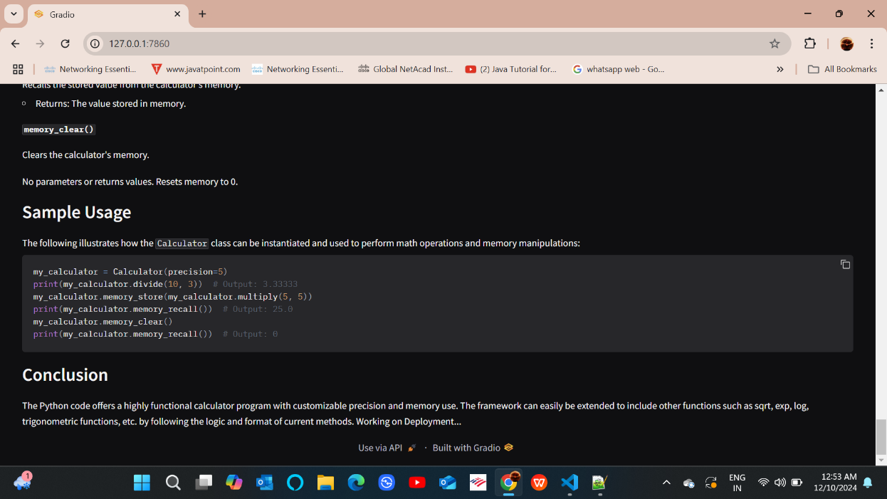
Documentation
The Python code offers a highly functional calculator program with customizable precision and memory use. The framework can easily be extended to include other functions such as sqrt, exp, log, trigonometric functions, etc. by following the logic and format of current methods. Working on Deployment...

Slide 21
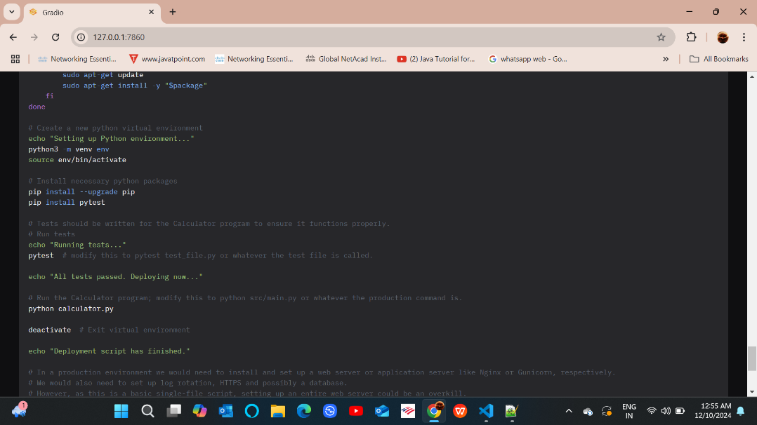
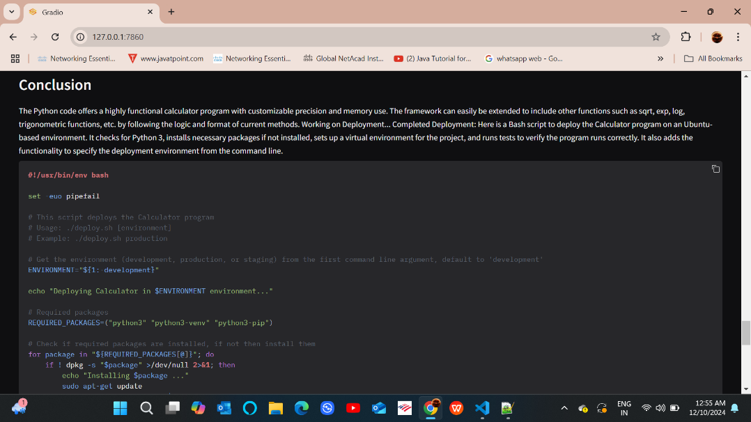
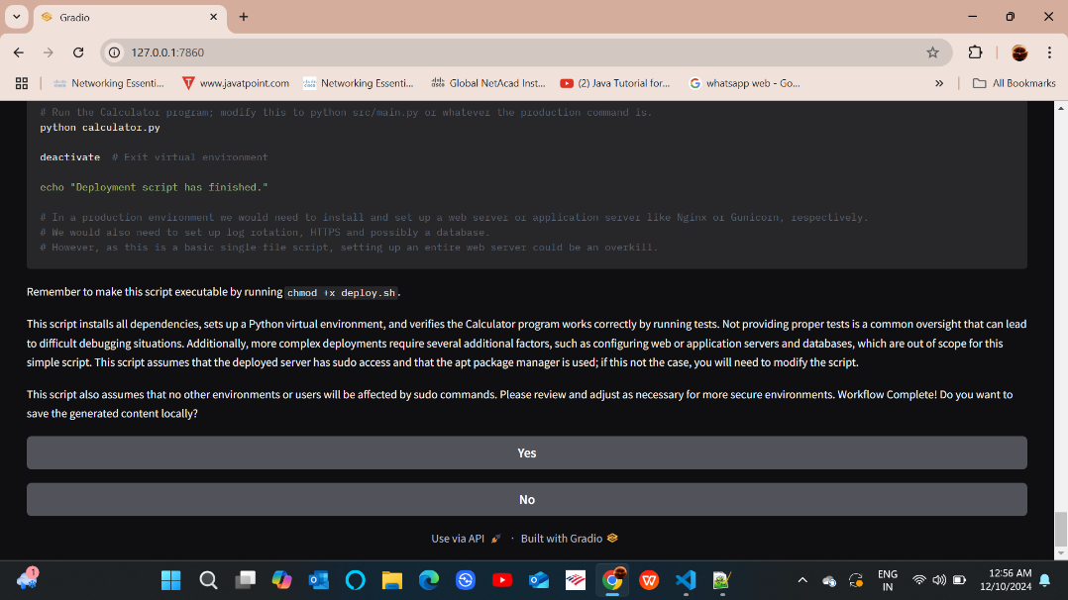
Project Setup
This script installs all dependencies, sets up a Python virtual environment, and verifies the Calculator program works correctly by running tests.

Slide 22
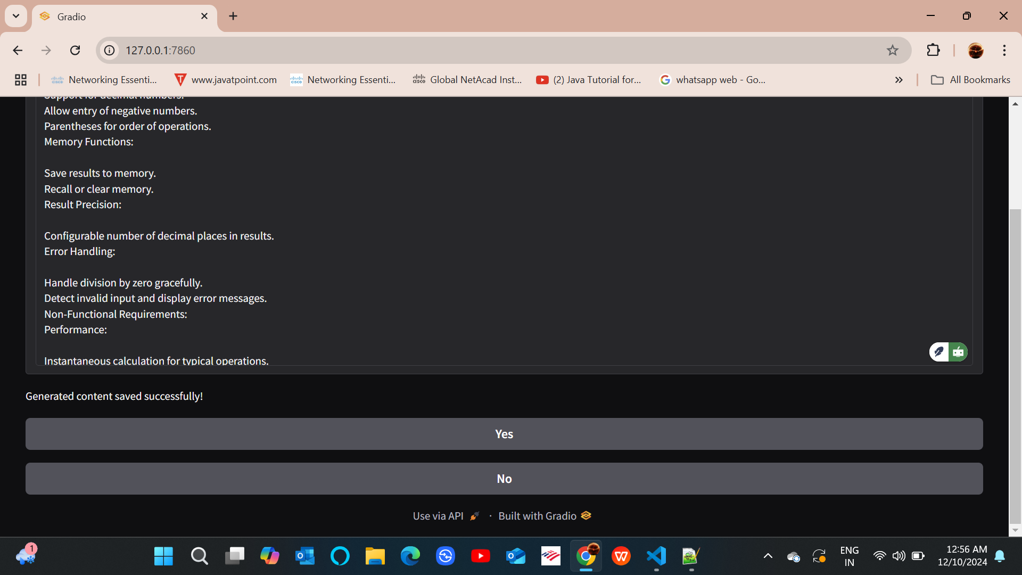
Generated content saved successfully

Slide 23
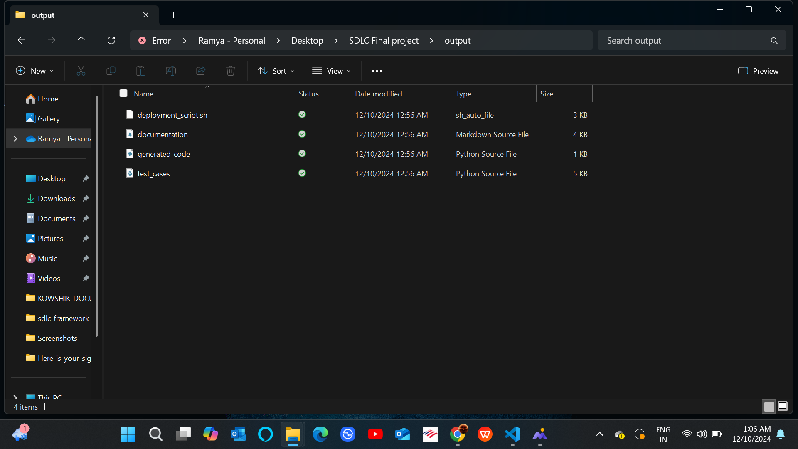
Different Output Files

Slide 24
Benefits
Time Efficiency: Automated processes reduce manual effort, allowing developers to focus on critical tasks and accelerate project timelines.
Error Reduction: Enhanced accuracy in task execution and monitoring minimizes errors and ensures higher quality deliverables.
Improved Collaboration: Centralized workflows promote transparency and seamless interaction among team members.
Future Scalability: The flexible architecture supports the integration of emerging technologies for continuous improvement.

Slide 25
Conclusion
Comprehensive SDLC Tool: Successfully developed a tool enhancing software development lifecycle through automated workflows and efficient task management.
Scalable Design: Built a robust and extendable architecture, ensuring adaptability to evolving project requirements and future feature enhancements.
Performance-Oriented: Delivered optimized functionalities with a focus on speed, accuracy, and error handling for seamless development experiences.
Future-Ready Solution: Positioned the tool for integration with emerging technologies, paving the way for advanced automation and intelligence-driven development.

Slide 26
Future Scope
Streamlined Automation:
Automates the entire SDLC workflow, saving time and reducing manual effort.
Enhanced Productivity:
Allows users to focus on strategic tasks while routine processes are managed efficiently.
Standardized Output Quality:
Ensures consistency across all phases: coding, testing, documentation, and deployment.
Real-Time Progress Visibility:
Provides live updates, ensuring transparency and better workflow management.
Efficient Output Management:
Automatically saves outputs in an organized structure, simplifying review and usage.

Slide 27
Queries…?

Slide 28
Thank You

